Slide 1
Welcome!
-Team Darkside
Notes:
Describe our team product

Slide 2
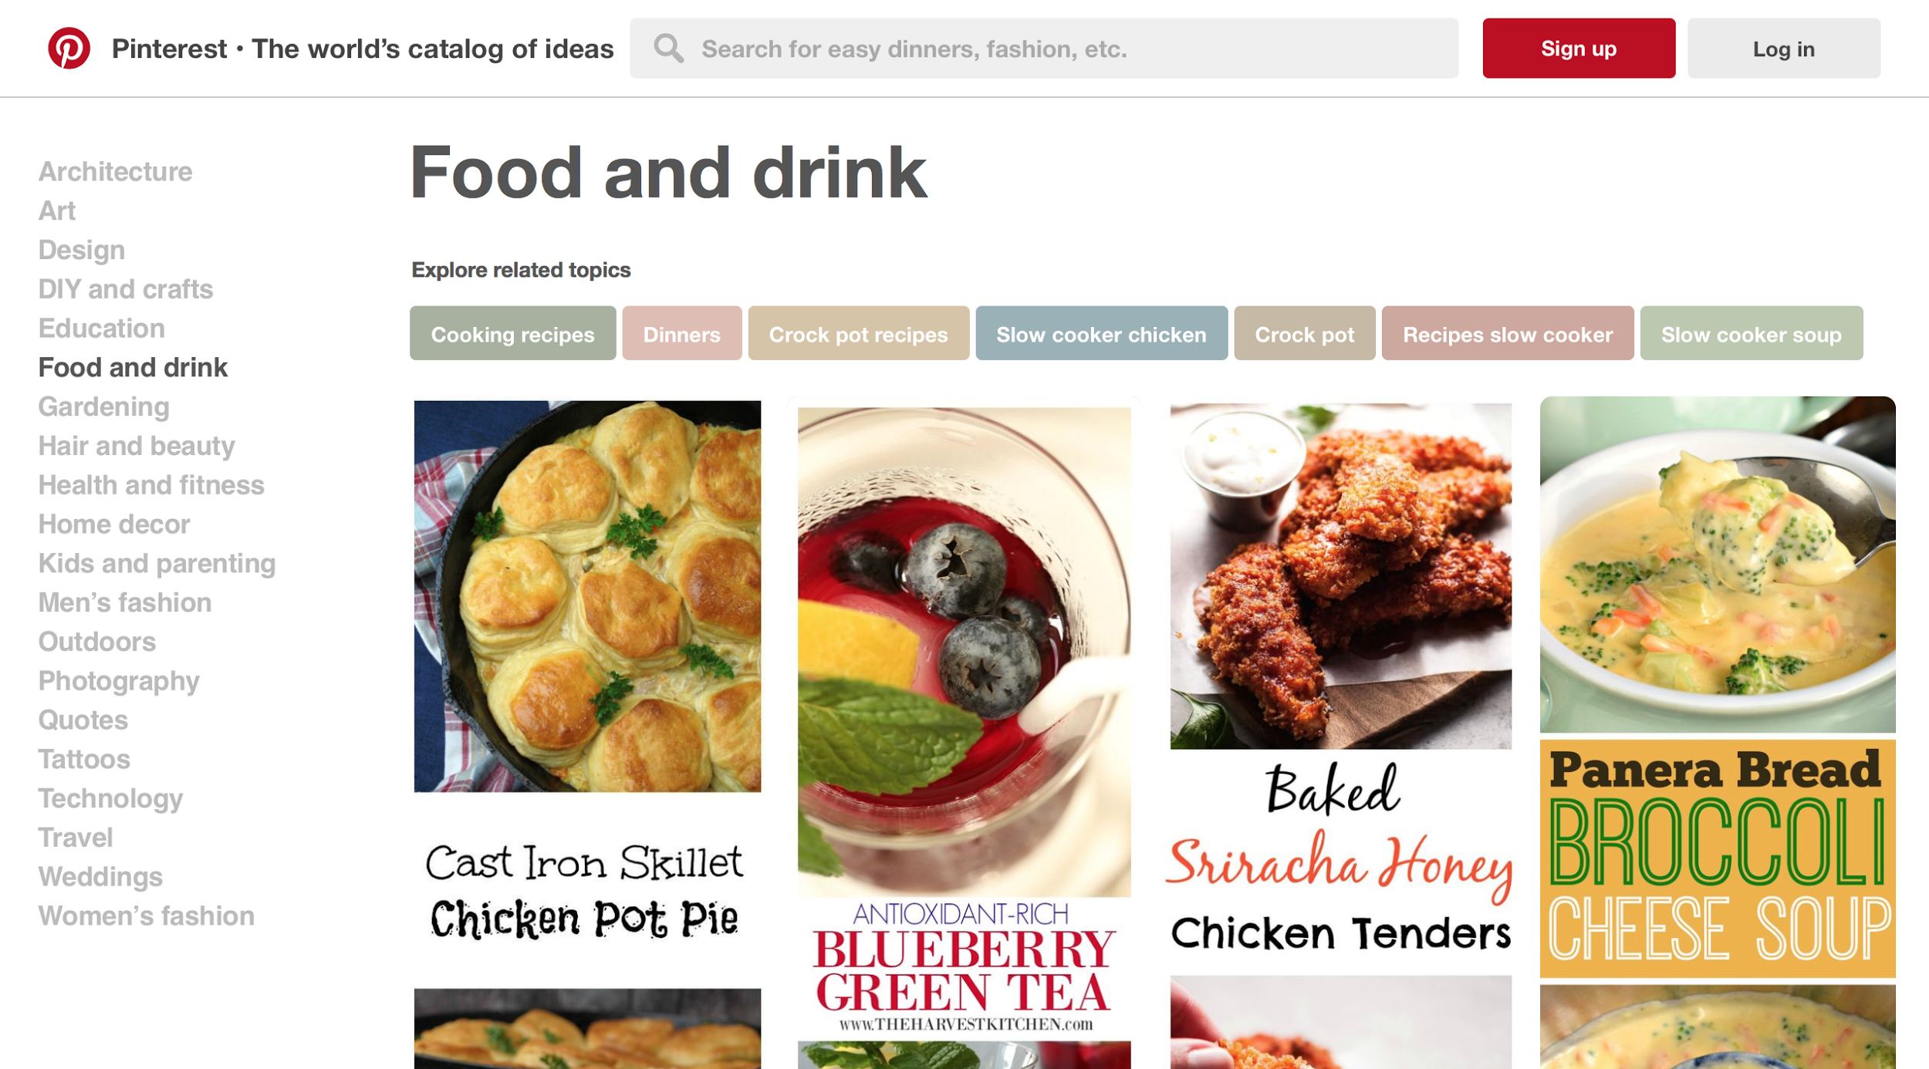
What’s Wrong with this Picture?

Slide 3
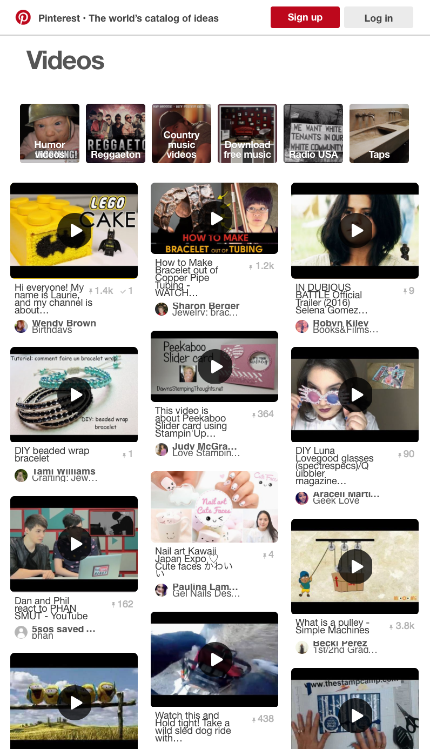
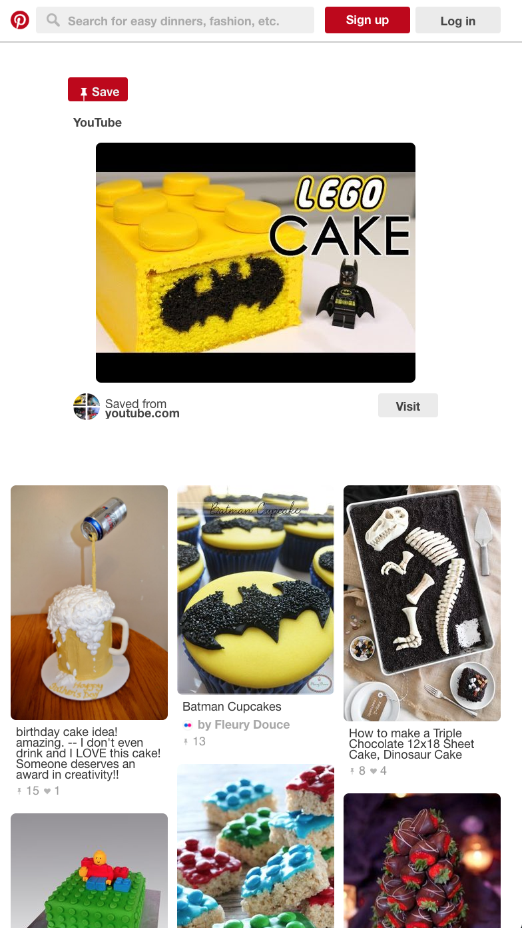
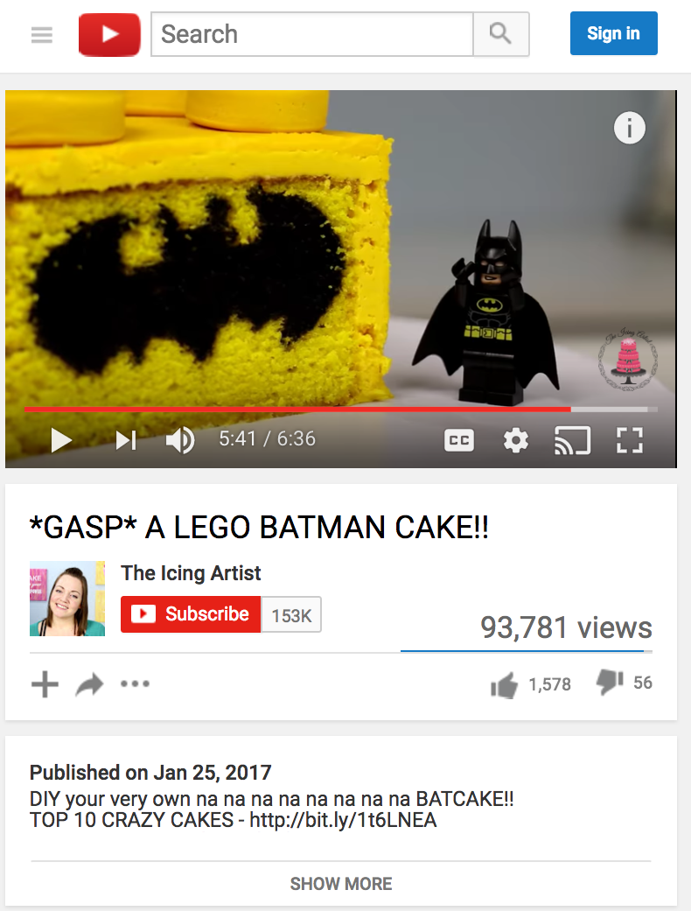
Step #1 Step #2 Step #3

Slide 4
Say Goodbye To Pinterest
Notes:
Describe our team product

Slide 5
Say Hello to Bookmarked!

Slide 6

What is Bookmarked?
Based off of Pinterest
Expanding capabilities beyond Pinterest with the addition of video bookmarks
Simple, clean design
Tagging and category system
Notes:
Describe our team product

Slide 7
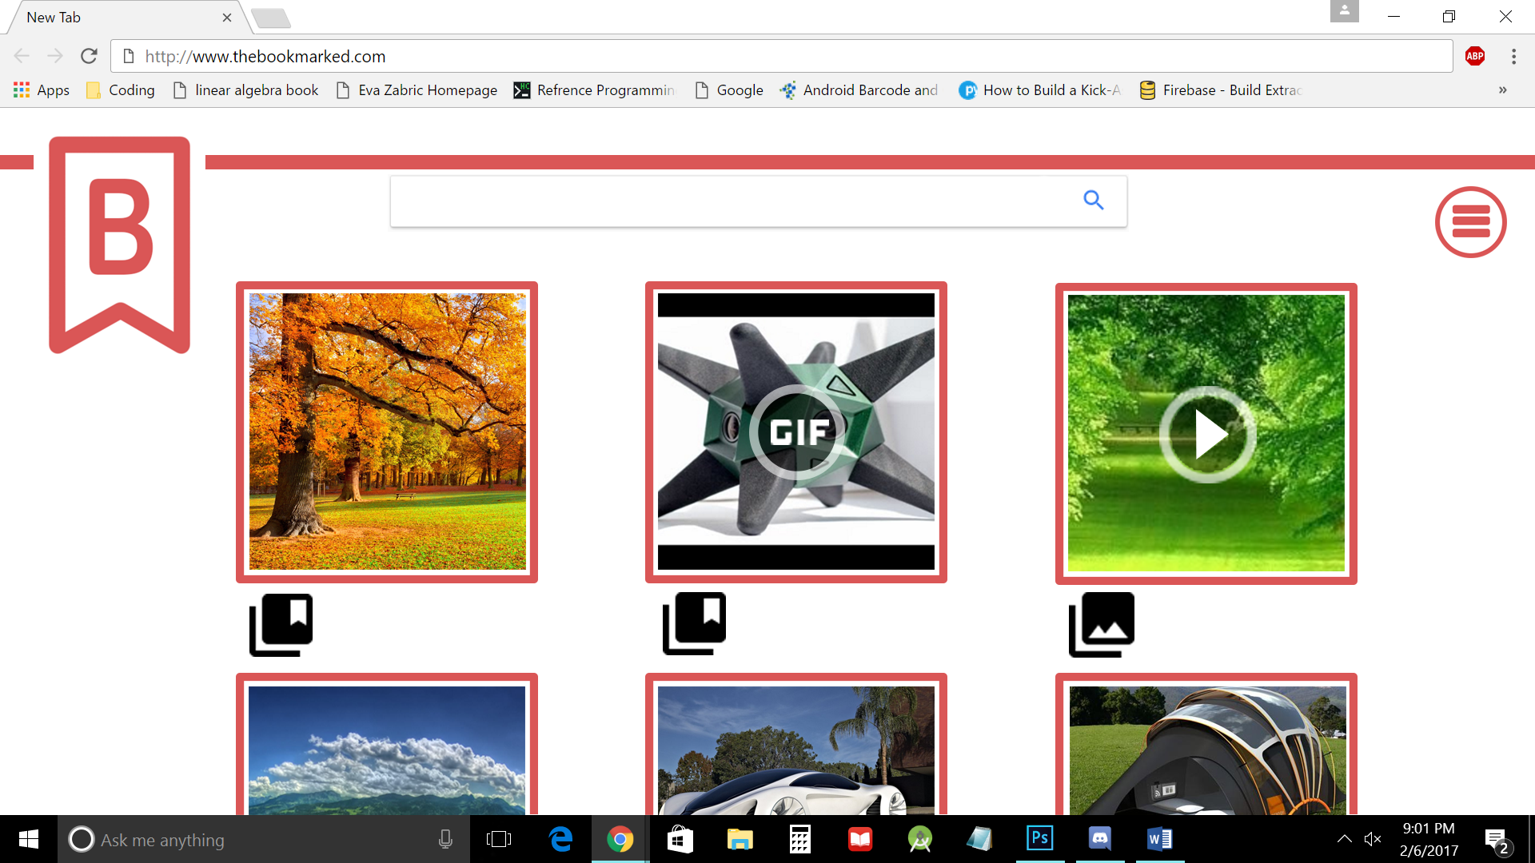

Slide 8
How We’ll Accomplish Bookmarked!
Let’s start booking it!

Slide 9
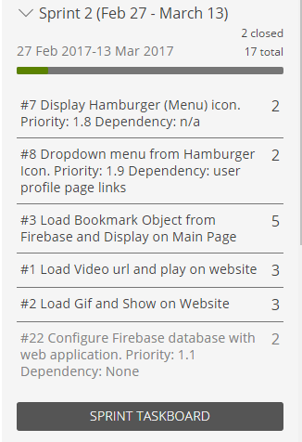
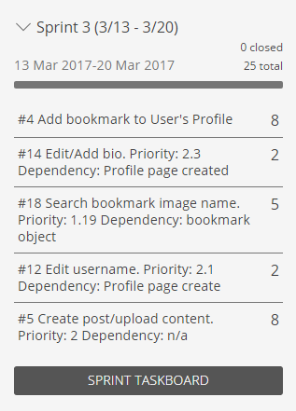
Midterm Release: Features

Slide 10
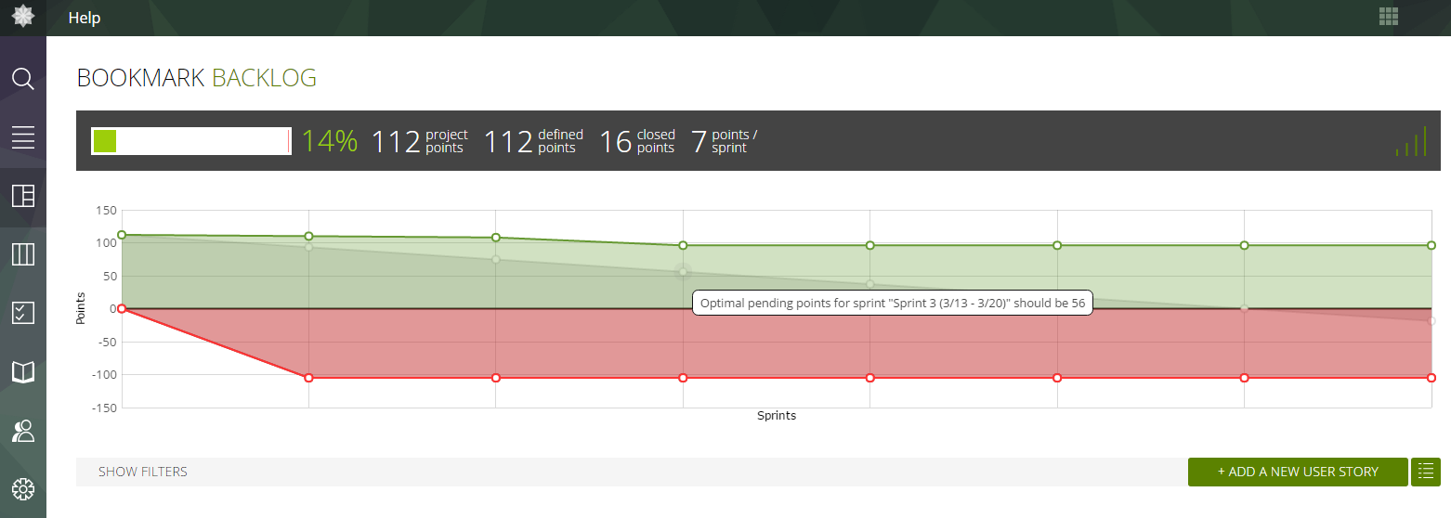
Midterm Release: Story Points

Slide 11
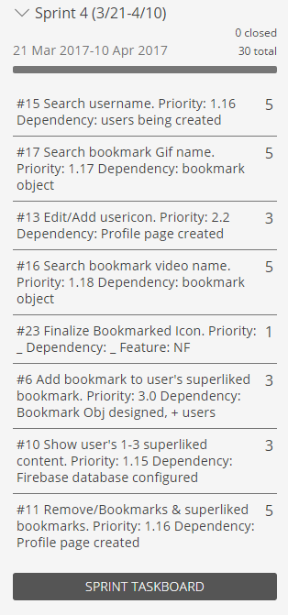
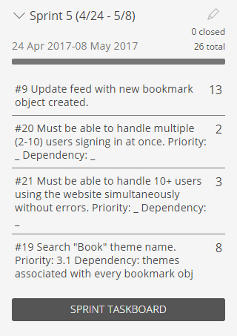
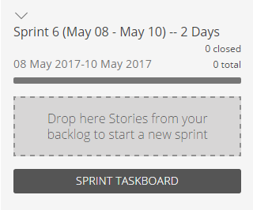
Final Release: Features

Slide 12
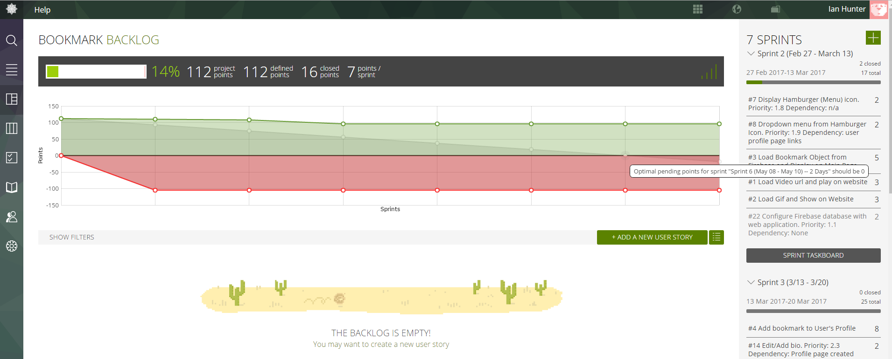
Final Release: Story Points

Slide 13
Definition of Done
1. Feature
2. Sprint
3. Release

Slide 14
Feature Level
Do the features pass their test cases for each of the requirements necessary for the feature to function?
Notes:
Describe our team product

Slide 15
Sprint Level
Does the regression testing pass when the new feature is integrated into the production branch?
Notes:
Describe our team product

Slide 16
Release Level
Is the feature fully usable and presentable for the customer?
Did we mitigate technical debt?
Notes:
Such as cleaning up code that was giving us issues.
Usable means: “Do the alpha testers have any issues with the features or any concerns?”

Slide 17
Questions?

